Slide 1
Unicorn Companies
Data Analysed with Jupyter Note book.

Slide 2
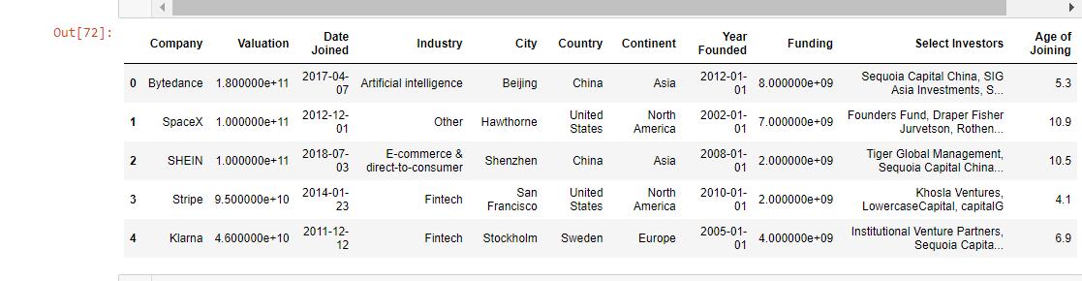

Slide 3
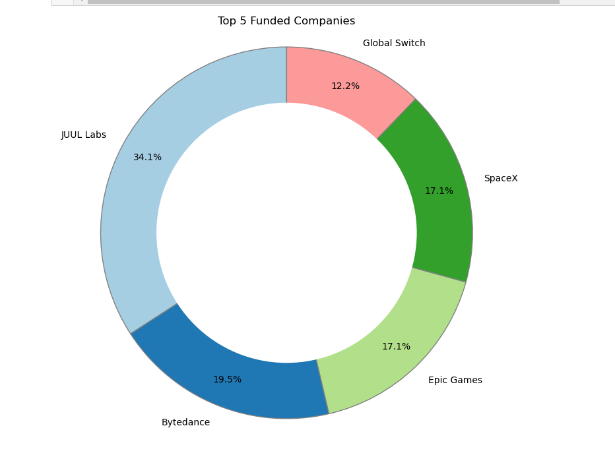

Slide 4
Challenges…
Cleaning the data was hectic which took several hours before it was accomplished.
There are several difficulties while analysing and visualizing the extracted data. E.g; error in codes etc
Indecisiveness in what form the visualization should be considering acceptability.
…….and many more

Slide 5
Overall Recommendation….
In summary, the dataset explicitly indicate that funding into the companies and industries were majorly tilted to few ones while larger part of these were not properly funded which brought down their valuations.
Recommending that the stakeholders/selected investors should unanimously generalize their investment such that every associated company and industry will experience adequate funding and in return brings presentable valuations.

